Slide 1

2. Component-Oriented Design and Architecture
CBSE – Mundtlig Eksamen
pahan19@student.sdu.dk
Patrick Hansen

Slide 2
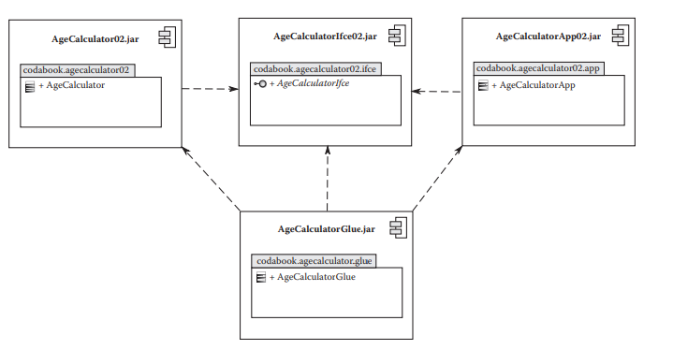
Hvad er et komponent?
Brug
Interfaces
Fjerne tæt kobling
Glue kode
Notes:
Karakteristika
Et komponent baseret system kan samles og skilles ad.
Et sæt af relevant komponenter giver os et fuldt system
Komponent baseret system udvikles typisk som en samling af mindre dele
Fordele
Løse problemer vha. Separation of Concerns
Opdele ansvars områder
Genanvendelighed
Composition
Maintainability (testing, udskiftning, videre udvikling, bug-fixing)
Normalt skal software integreres, men kan vi ikke samle det i stedet? Composition
Brug
Interfaces giver os Dependency Inversion og Inversion of control.
Glue kode er en form for manuel assembly der kan ske automatisk med en component model
Interfaces
The use of interfaces eliminates the tight coupling between components during the build time.
If you import a component w/o the use of interfaces, you depend on the component you imported.
This means that the application component could not be developed in isolation from the
business component. This is an impediment to independent component fabrication.
To solve the build time dependency problem, we can make use of Java interface construct.
## What is glue code? Why is it required?
Glue code is needed to make **new** instances of a interface with the type of class needed.
Example: InterfaceType instance = **new** ConcreteImp;
## What is the alternative to using glue code?
Automate the component assembly using a component model and component framework.

Slide 3
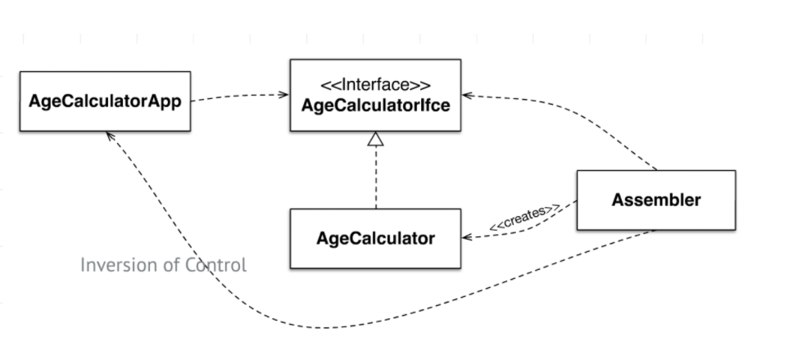
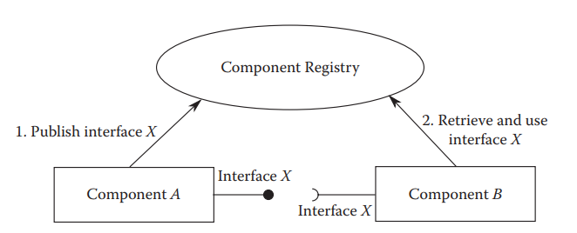
Komponent modeller
Whiteboard
Publish, consume
Dependency Injection
Constructor, Setter injection
Inversion of Control
Dependency Inversion
Notes:
### Dependency injection-based component models
Each component declares the set of interfaces provided by it and the set of interfaces required by it.
- The component framework analyzes this information on all the deployed components and injects the providing component references to requiring components
### Publish and consume whiteboard query-based component models
Each component registers the set of provided interfaces with a whiteboard registry.
- Any component requiring an interface queries the whiteboard registry to obtain a reference to the providing component.

Slide 4
Komponent framework
Specifikationer og implementationer deraf, herunder modellerne
Giver os redskaberne til at automatisere assembly m.m.
- Uden at introducere buildtime dependencies…

Slide 5
Portefølje Eksempel: OSGi Enemy
Declarative Services
BundleContext
<?xml version="1.0" encoding="UTF-8"?> <scr:component xmlns:scr="http://www.osgi.org/xmlns/scr/v1.1.0" name="dk.sdu.mmmi.cbse.osgienemy"> <implementation class="dk.sdu.mmmi.cbse.osgienemy.EnemyProcessor"/> <service> <provide interface="dk.sdu.mmmi.cbse.common.services.IEntityProcessingService"/> </service> <reference bind="setBulletService" cardinality="0..1" interface="dk.sdu.mmmi.cbse.common.bullet.BulletSPI" name="BulletService" policy="dynamic" unbind="removeBulletService"/> </scr:component>
Bundle bundle = FrameworkUtil.getBundle(BulletSPI.class); BundleContext context = bundle.getBundleContext(); ServiceReference bulletSR = context.getServiceReference(BulletSPI.class); private BulletSPI bulletService = (BulletSPI) context.getService(bulletSR);
Activator
Setter Injection
public class Activator implements BundleActivator { @Override public void start(BundleContext context) throws Exception { LaserSystem ls = new LaserSystem(); context.registerService(IEntityProcessingService.class, ls, null); context.registerService(BulletSPI.class, ls, null); }
public void setBulletService(BulletSPI bulletService) { this.bulletService = bulletService; } public void removeBulletService(BulletSPI bulletService) { this.bulletService = null; }
Notes:
OSGi Eksempler
Declarative Services, dependency injection
BundleContext, whiteboard modellen
Activator

Slide 6
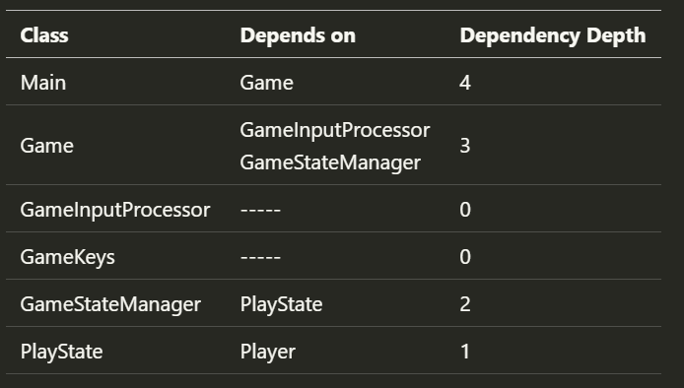
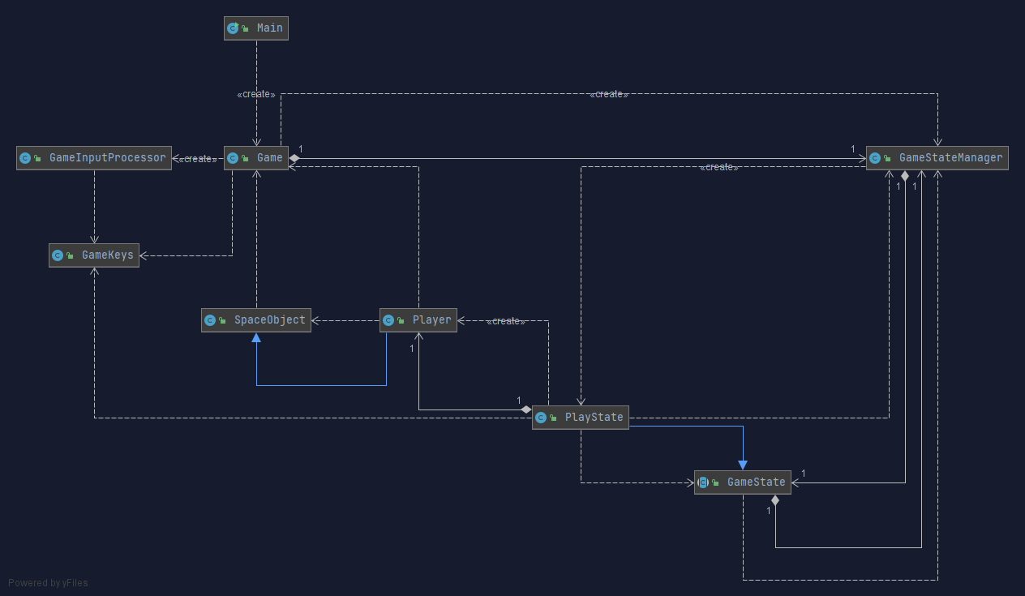
Kobling og samhørighed
Tæt kobling
Ulemper
Hvordan måler vi kobling?
Notes:
Coupling is the measuure of interdependence between modules.
Tight coupling means a large amount of interdependence between modules.
The lowest amount of coupling is _data coupling_, meaning that the dependency between modules is only data passed between them.
The worst amount if _content coupling_, where one module can modify another.
## Why is tight coupling not advisable?
If we have tight coupling, our system is harder to understand, maintain and reuse.
1. High resistance to change in implementation.
Modules that know too much about other modules make changes hard to coordinate and make modules brittle. If Module A knows too much about Module B, changes to the internals of Module B may break functionality in Module A.
## How do we measure the amount of coupling present in a design?
By assessing the class's dependency depth.
> A class that has no dependency has a dependency depth of 0.
>
> Any other class that depends on a class with a dependency depth of 0 has a dependency depth of 1.
>
> Any class that depends on a class with a dependency depth of 1 would have a dependency depth of 2, and so on.
>
> Higher dependency depth implies higher tight coupling

Slide 7
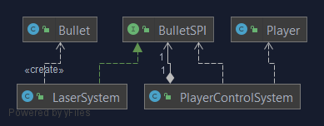
Business entiteter
Data
Instantiering
Kommunikation
Kommunikation
if (gameData.getKeys().isDown(GameKeys.SPACE)) { Entity bullet = bulletService.createBullet(player, gameData); world.addEntity(bullet); }
Notes:
PlayerControlSystem kan instantiere en player
Kan få fat i en Service Provider af BulletSPI og passere player til LaserSystem og dermed kommunikere

